Slide 1
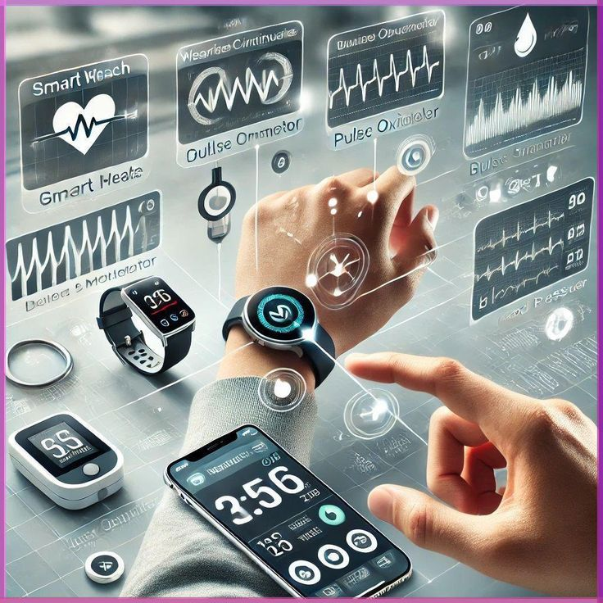
PARAHEALTH System

Slide 2
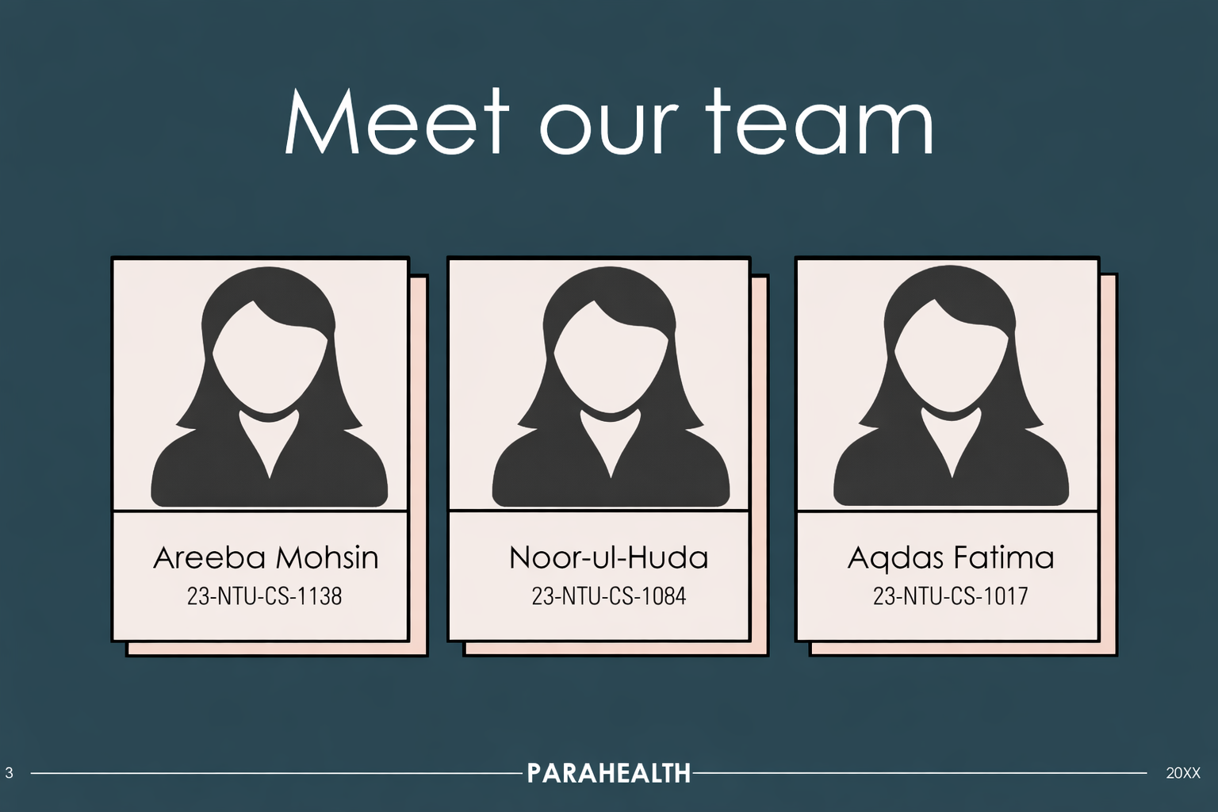

Slide 3
INTRODUCTION
PARAHEALTH is a compact health monitoring system that continuously tracks a patient’s vital signs using an ESP32 and various sensors. It measures heart rate, blood oxygen (SpO₂), body temperature, as well as room temperature and humidity. To ensure safety, the system triggers a buzzer and sends alerts to the Blynk mobile app whenever any reading goes beyond safe limits.

Slide 4
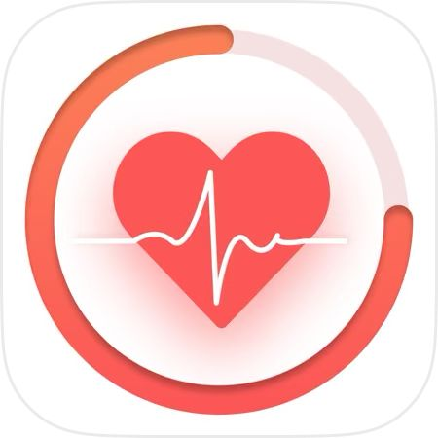

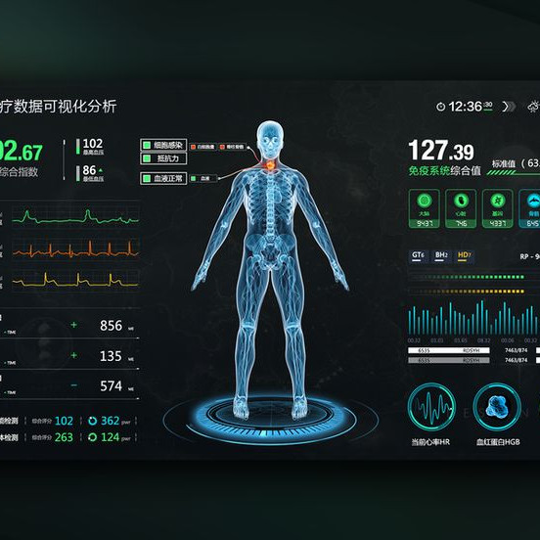


Objective
1
To track the patient’s heart rate and SpO₂ using sensor technology.
2
To record body temperature as well as ambient temperature and humidity.
3
To show all health readings on a mobile app.
4
To alert the user in case of abnormal health readings.
5
To develop an affordable and user-friendly health monitoring system.

Slide 5
:
Sensor Activation:
Once connected, all sensors start measuring:
MAX30100 → Heart rate & SpO₂
LM35 → Body temperature
DHT11 → Room temperature & humidity
Functionality
.
Data Transmission:
All readings are sent to the Blynk mobile application for real-time monitoring.
WiFi Connection:
ESP32 connects to the WiFi network and then to the Blynk cloud using the authentication token.
Alerts:
If any reading goes beyond safe limits, the buzzer turns ON and alert message is sent to the mobile app
:
Data Display:
Sensor readings are shown on the Serial Monitor.
5
PARAHEALTH
04/1/26
1

Slide 6
.
Functionality
Sensor Activation:
Once connected, all sensors start measuring:
MAX30100 → Heart rate & SpO₂
LM35 → Body temperature
DHT11 → Room temperature & humidity
Data Transmission:
All readings are sent to the Blynk mobile application for real-time monitoring.
WiFi Connection:
ESP32 connects to the WiFi network and then to the Blynk cloud using the authentication token.
Alerts:
If any reading goes beyond safe limits, the buzzer turns ON and alert message is sent to the mobile app.:
02
03
01
Data Display:
Sensor readings are shown on the Serial Monitor.
04
6
PARAHEALTH

Slide 7
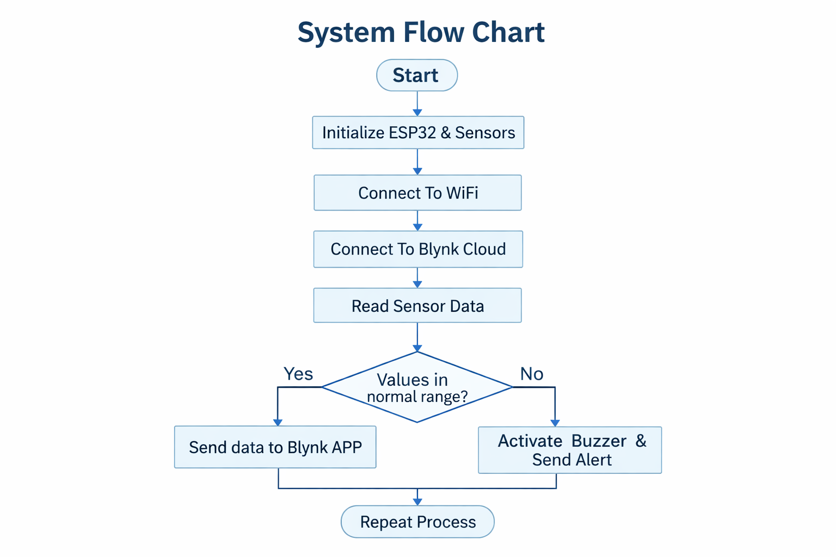
Flowchart

Slide 8
USE OF BLYNK In our PARAHEALTH project, the Blynk mobile application displays all the health data collected by the system. It shows a heart rate gauge and a SpO₂ percentage to monitor oxygen levels. The app also presents body and room temperature readings along with humidity levels. If any parameter goes beyond safe limits, the app receives alert messages to notify the user immediately. Additionally, it provides a manual alarm reset button to turn of The buzzer after addressing issue

Slide 9
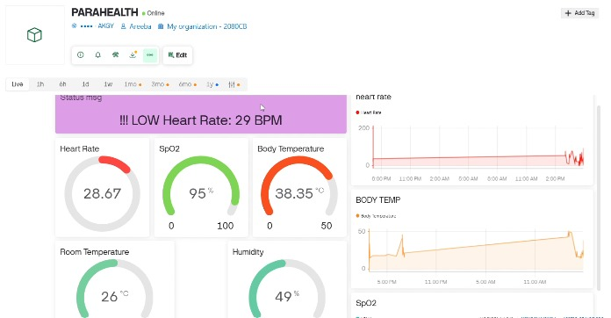
Blynk Connection

Slide 10
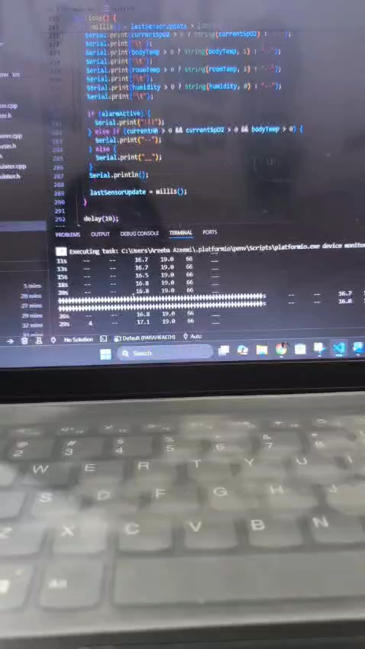
WORKING

Slide 11
“
CONCLUSION
”

Slide 12
The PARAHEALTH project successfully demonstrates a real-time patient health monitoring system using IoT. It reduces the need for manual checking and provides instant alerts in case of emergencies. The system is reliable, low-cost, and easy to use, making it suitable for home and small healthcare environments

Slide 13
Thankyou

